Slide 1


AI Agents
Enabling game entities to act autonomously.

Slide 2

AI Agents

Slide 3
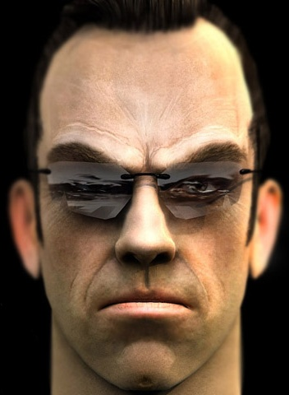
“An autonomous agent is a system situated within and a part of an environment that senses that environment and acts on it, over time, in pursuit of its own agenda and so as to effect what it senses in the future.”
Agents may act as an
Opponent
Ally
Neutral character
Loops through the following cycle:
Sense ► Think ► Act
Optional learning or remembering step

Slide 4

Sensing - Sight
Within a game, agents can have access to perfect information about the game world (e.g. complete terrain layout, location and state of the player, etc.).
Often a sensing model is used to avoid agent ‘cheating’ and ensure agents cannot ‘see’ through walls, know about unexplored areas, etc.
For each game object:
Is it within the viewing distance of the agent?
Is it within the viewing angle?
Is it unobscured by the environment?

Slide 5
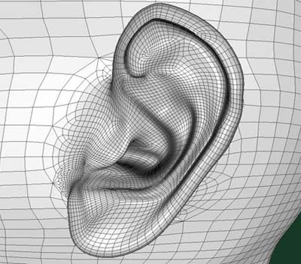


Sensing - Sound
Do agents respond to sound? If so, how is sound propagation modelled?
An event based model is typically used:
When sound is emitted, it alerts interested agents
Use distance and zones to determine how far sound can travel
Travel distance may also depend upon type of incident surface and movement speed of the player, etc.

Slide 6
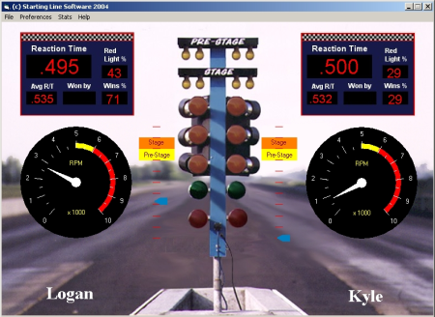
Sensing - Reacting
Agents should not normally see, hear and communicate instantaneously (or rather immediately commence actions following the sensing stage)
Normally sufficient to introduce artificial reaction times, e.g.:
Vision: ¼ to ½ second
Hearing: ¼ to ½ second
Communication: > 2 seconds

Slide 7

Thinking
Approaches towards agent AI ‘decision making’ (not mutually exclusive) include:
Use pre-coded expert knowledge
Algorithmically search for a solution
Many different techniques exist (we will explore some later)
Aside: Encoding expert knowledge is appealing as it is relatively easy to obtain and use, but may not be scalable or adaptable.
Whilst often scalable and adaptable, algorithmic approaches may not perform as well and might be computationally expensive.

Slide 8


Thinking
Dumbing agents down:
Sometimes it may be necessary to ‘dumb down’ agents, for example:
Make shooting less accurate
Introduce longer reaction times
Change locations to make self more vulnerable, etc.
Letting agents cheat:
This is sometimes necessary for:
Highest difficultly levels
CPU computation reasons
Development time reasons

Slide 9


Acting
Sensing and thinking steps are invisible to player, i.e. acting is how player witnesses intelligence. Example of actions include:
Move location
Pick up object
Play animation
Play sound effect
Fire weapon
Talk to player
Agents might also use event-driven communication to alter other agents or share knowledge (e.g. player last seen at location x).

Slide 10

Key takeaways:
AI controlled agents within a game often use a Sense ► Think ► Act sequence to segment and define their AI behaviour.

